Slide 1
CS118 – Programming Fundamentals
Lecture # 10
Tuesday, September 23, 2019
FALL 2019
FAST – NUCES, Faisalabad Campus
Course Instructor:
Ebad Majeed
Slides Credit:
Rizwan Ul Haq

Slide 2
Selection: if and if...else
One-Way Selection
Two-Way Selection
Compound (Block of) Statements
Multiple Selections: Nested if
Comparing if...else Statements with a Series of if Statements

Slide 3
One-Way Selection
The syntax of one-way selection is:
The statement is executed if the value of the expression is true
The statement is bypassed if the value is false; program goes to the next statement
if is a reserved word

Slide 4
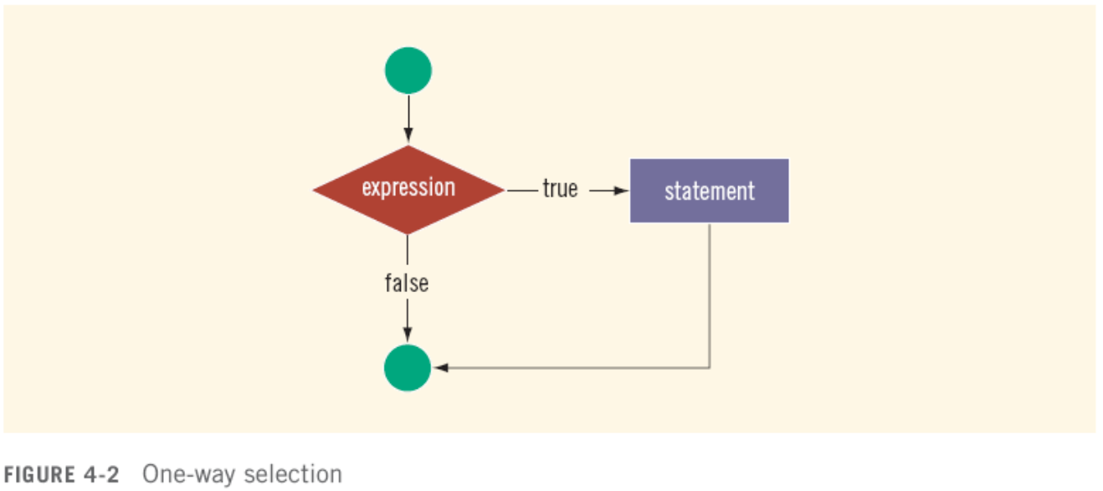
One-Way Selection (cont'd.)

Slide 5
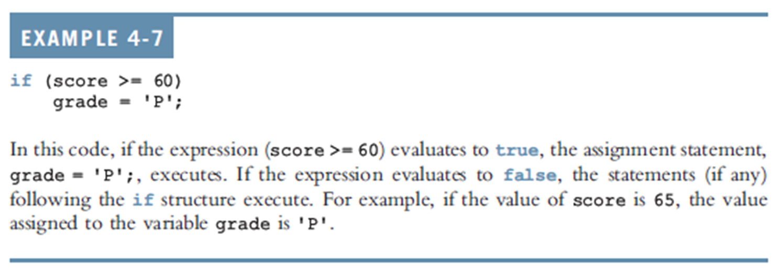
One-Way Selection (cont'd.)

Slide 6
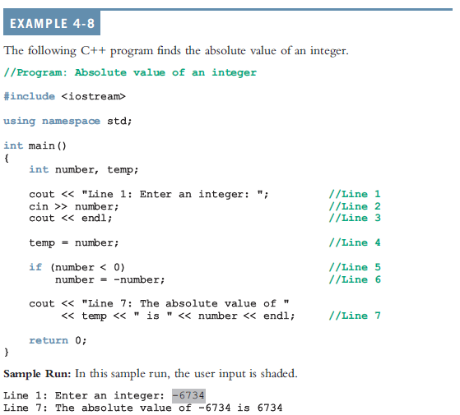

Slide 7
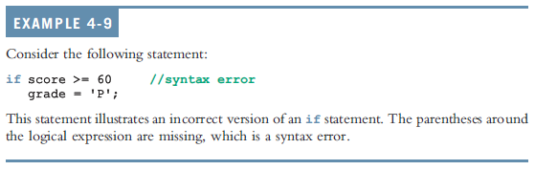
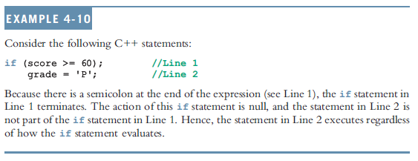
One-Way Selection (cont'd.)

Slide 8
Two-Way Selection
Two-way selection takes the form:
If expression is true, statement1 is executed; otherwise, statement2 is executed
statement1 and statement2 are any C++ statements
else is a reserved word

Slide 9
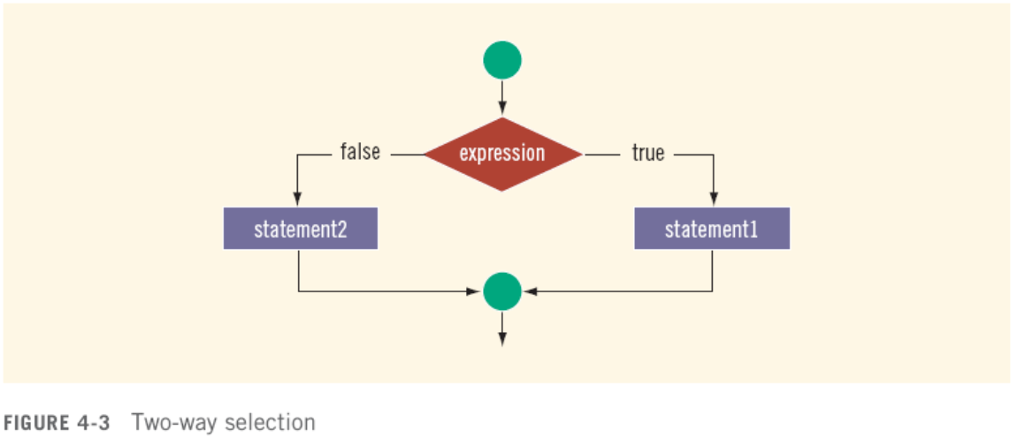
Two-Way Selection (cont'd.)

Slide 10
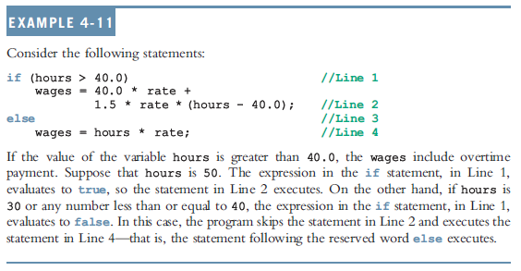
Two-Way Selection (cont'd.)

Slide 11
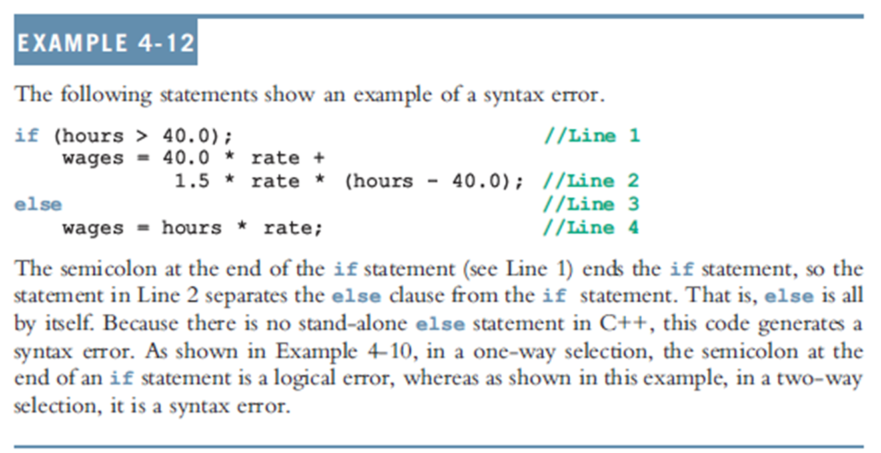
Two-Way Selection (cont'd.)

Slide 12
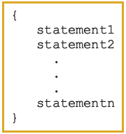
Compound (Block of) Statements
Compound statement (block of statements):
A compound statement is a single statement

Slide 13
Compound (Block of) Statements (cont'd.)
if (age > 18)
{
cout << "Eligible to vote." << endl;
cout << "No longer a minor." << endl;
}
else
{
cout << "Not eligible to vote." << endl;
cout << "Still a minor." << endl;
}

Slide 14
Multiple Selections: Nested if
Nesting: One control statement in another
An else is associated with the most recent if that has not been paired with an else

Slide 15
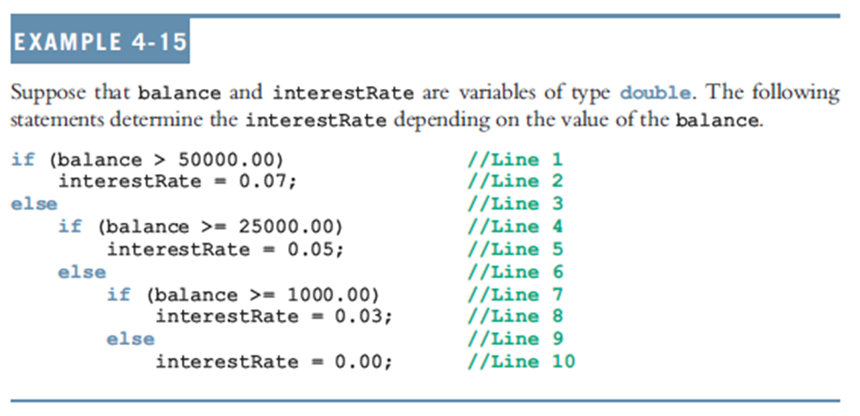
Multiple Selections: Nested if (cont'd.)

Slide 16
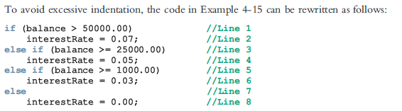
Multiple Selections: Nested if (cont'd.)

Slide 17
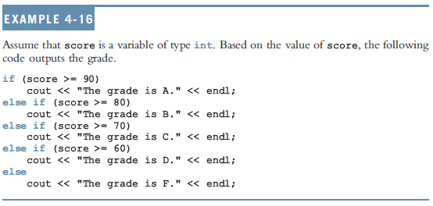
Multiple Selections: Nested if (cont'd.)

Slide 18
if-else Pairing
Assume that all the variables are properly declared and consider the following statements:
if(gender == 'M') //Line 1
if(age < 21) //Line 2
policyRate = 0.05; //Line 3
else //Line 4
policyRate = 0.035; //Line 5
else if (gender = 'F') //Line 6
if(age < 21) //Line 7
policyRate = 0.04; //Line 8
else //Line 9
policyRate = 0.03; //Line 10
In this code, the else in Line 4 is paired with the if in Line 2. Note that for the else in Line 4, the most recent incomplete if is the if in Line 2. The else in Line 6 is paired with the if in Line 1. The else in Line 9 is paired with the if in Line 7. Once again the indentation does not determine the pairing, but it communicates the pairing

Slide 19
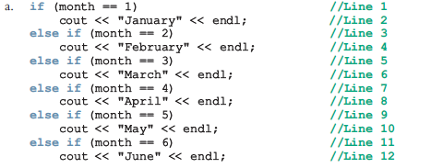
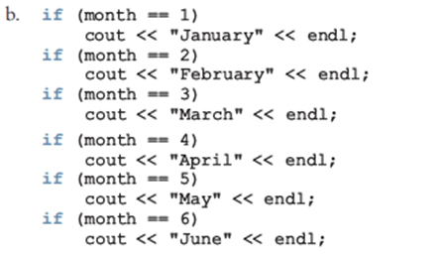
Comparing if…else Statements with a Series of if Statements

Slide 20
Short-Circuit Evaluation
Short-circuit evaluation: evaluation of a logical expression stops as soon as the value of the expression is known
Example:
Assume x = 21, y=5, z = 3, ch = ‘B’
(x >= 20) || ( y == 10) //Line 1
(ch == 'A') && (z < 7) //Line 2

Slide 21
Comparing Floating-Point Numbers for Equality: A Precaution
Comparison of floating-point numbers for equality may not behave as you would expect
Example:
1.0 == 3.0/7.0 + 2.0/7.0 + 2.0/7.0 evaluates to false
Why? 3.0/7.0 + 2.0/7.0 + 2.0/7.0 = 0.99999999999999989
Solution: use a tolerance value
Example: fabs(x – y) < 0.000001

Slide 22
#include<iostream>
#include <iomanip>
#include<cmath>
using namespace std;
int main()
{
double x =1.0;
double y = 3.0 / 7.0 + 2.0 / 7.0 + 2.0 / 7.0 ;
cout << fixed << showpoint << setprecision(17);
cout << "3.0 / 7.0 + 2.0 / 7.0 + 2.0 / 7.0 = "
<< 3.0 / 7.0 + 2.0 / 7.0 + 2.0 / 7.0 << endl;
cout << "x = " << x << endl << "y = " << y << endl;
if(x == y)
cout << "x and y are same" <<endl;
else
cout << "x and y are not same" << endl;
if (fabs(x-y)<0.000001)
cout << "x and y are same within the tolerance 0.000001" << endl;
else
cout << "x and y are not same within the tolerance 0.000001" << endl;
return 0;
}
Sample Run:
3.0 / 7.0 + 2.0 / 7.0 + 2.0 / 7.0 = 0.99999999999999989
x = 1.00000000000000000
y = 0.99999999999999989
x and y are not the same.
x and y are the same within the tolerance 0.000001.

Slide 23
Associativity of Relational Operators: A Precaution
#include<iostream>
using namespace std;
int main()
{
int x;
cout << "Enter and integer = " ;
cin >> x ;
cout << endl ;
if (0 <= x <= 10)
cout << x << " is within 0 and 10" << endl;
else
cout << x << " is not within 0 and 10" << endl;
return 0;
}
Notes:
X = 7
X = 30

Slide 24
Associativity of Relational Operators: A Precaution (cont’d.)
x = 7
x = 30
0 <= x <= 10 | = 0 <= 7 <= 10
 | = (0 <=7) <= 10 | Because relationship operators are evaluated from left to right
 | = 1 <= 10 | Because 0<=7 is true, 0<=7 evaluates to 1
 | = 1 (true)
0 <= x <= 10 | = 0 <= 30 <= 10
 | = (0 <=30) <= 10 | Because relationship operators are evaluated from left to right
 | = 1 <= 10 | Because 0<=30 is true, 0<=30 evaluates to 1
 | = 1 (true)
Solution:
0 <= x && x <= 10

Slide 25
Avoiding Bugs by Avoiding Partially Understood Concepts and Techniques
Must use concepts and techniques correctly;
Otherwise solution will be either incorrect or deficient
If you do not understand a concept or technique completely
Don’t use it
Save yourself an enormous amount of debugging time

Slide 26
Input Failure and the if Statement
If input stream enters a fail state
All subsequent input statements associated with that stream are ignored
Program continues to execute
May produce erroneous results
Can use if statements to check status of input stream
If stream enters the fail state, include instructions that stop program execution
if(cin)

Slide 27
Confusion Between the Equality (==) and Assignment (=) Operators
C++ allows you to use any expression that can be evaluated to either true or false as an expression in the if statement:
if (x = 5)
cout << "The value is five." << endl;
The appearance of = in place of == resembles a silent killer
It is not a syntax error
It is a logical error

Slide 28
Conditional Operator (?:)
Conditional operator (?:) takes three arguments
Ternary operator
Syntax for using the conditional operator:
expression1 ? expression2 : expression3
If expression1 is true, the result of the conditional expression is expression2
Otherwise, the result is expression3

Slide 29
Conditional Operator (?:)
Consider the following statement
if(x >= y)
large = x;
else
large = y;
You can use the conditional operator to simplify the writing of this if…else statement as follows:
large = (x >= y)? x: y ;

Slide 30
Program Style and Form (Revisited): Indentation
If your program is properly indented
Spot and fix errors quickly
Show the natural grouping of statements
Insert a blank line between statements that are naturally separate
Two commonly used styles for placing braces
On a line by themselves
Or left brace is placed after the expression, and the right brace is on a line by itself

Slide 31
Using Pseudocode to Develop, Test, and Debug a Program
Pseudocode, or just pseudo
Informal mixture of C++ and ordinary language
Helps you quickly develop the correct structure of the program and avoid making common errors
Use a wide range of values in a walk-through to evaluate the program

Slide 32
Summary
Control structures alter normal control flow
Most common control structures are selection and repetition
Relational operators: ==, <, <=, >, >=, !=
Logical expressions evaluate to 1 (true) or 0 (false)
Logical operators: ! (not), && (and), || (or)

Slide 33
Summary (cont'd.)
Two selection structures: one-way selection and two-way selection
The expression in an if or if...else structure is usually a logical expression
No stand-alone else statement in C++
Every else has a related if
A sequence of statements enclosed between braces, { and }, is called a compound statement or block of statements

Slide 34
Summary (cont'd.)
Using assignment in place of the equality operator creates a semantic error
switch structure handles multiway selection
break statement ends switch statement
Use assert to terminate a program if certain conditions are not met

Slide 35
Questions

